Slide 1
Unit 4 Intel 8051 – Architecture and Programming
Addressing modes of 8051
8051 Instructions Set

Slide 2
Addressing Modes
▪ The way in which the data sources and destination
addresses are specified in the instruction is called
addressing mode.
▪ There are eight addressing modes available in the 8051:
1.
2.
3.
4.
5.
6.
7.
8.
Immediate
Register
Direct
Indirect
Indexed
Relative
Absolute
Long

Slide 3
Immediate Addressing
▪ The simplest way to get data to a destination is to make the
source of the data as a part of the instruction itself.
▪ Immediate operands are preceded by #
▪ Operand may be a numeric constant, a symbolic variable or an
arithmetic expression using constants, symbols and operators.
▪ Assembler computes the value and substitutes the immediate
data into the instruction
Example: MOV A,#12
▪ All instructions using immediate addressing use 8-bit data
▪ Exception: when initializing the data pointer, a 16-bit constant is
required
Example: MOV DPTR, #8000H
▪ Advantage: Immediate addressing is very fast since the value to
be loaded is included in the instruction.
▪ Disadvantage: Since the value to be loaded is fixed at compile-
time it is not very flexible

Slide 4
Register Addressing
▪ Certain register names may be used as a part of
the instruction as sources or destinations of
data.
▪ Registers A, DPTR, and R0 to R7 may be
named as a part of the instruction.
▪ Other registers in 8051 may be addressed using
the direct addressing mode.
▪ Examples:
ADD A,R7 ; add the values of A and R7
INC DPTR ; adding 1 to the data pointer
MUL AB
; multiplying unsigned values in A & B

Slide 5
Direct Addressing
▪ operand is specified by an 8-bit address field in the
instruction
▪ Examples:
ADD A,55H ; adds the values of A and contents of loc 55h
MOV P1, A ; transfers the content of acc to Port 1 (address 90H)
▪ Advantages:
Direct addressing is generally fast since, although the value to be
loaded isn’t included in the instruction, it is quickly accessible since
it is stored in the 8051’s Internal RAM.
❖ It is also much more flexible than Immediate Addressing since the
value to be loaded is whatever is found at the given address--which
may be variable.

Slide 6
Direct Addressing
▪ When using direct addressing any instruction which refers to an
address between 00h and 7Fh is referring to Internal Memory. Any
instrction which refers to an address between 80h and FFh is
referring to the SFR control registers that control the 8051
microcontroller itself.
▪ The obvious question that may arise is, "If direct addressing an
address from 80h through FFh refers to SFRs, how can I access the
upper 128 bytes of Internal RAM that are available on the 8052?“
▪
The answer is: You can’t access them using direct addressing. As
stated, if you directly refer to an address of 80h through FFh you will
be referring to an SFR. However, you may access the 8052’s upper
128 bytes of RAM by using the next addressing mode, "indirect
addressing."

Slide 7
Register Indirect Addressing
▪ instruction specifies a register which contains the address of the
operand.
▪ Both internal and external RAM can be indirectly addressed.
▪ The address register for 8-bit addresses can be R0 or R1 of the
selected register bank, or the Stack Pointer.
▪ The address register for 16-bit addresses can only be the data
pointer register, DPTR.
▪ indirect addressing is represented by an @ before R0 or R1.
▪ Example:
MOV A, @R0
; load the acc with the value from internal RAM which is found at
the address indicated by R0
MOVX A,@DPTR ; move the contents of the external memory address pointed to by
DPTR into the Accumulator
MOVX @DPTR,A ; write the value of the Accumulator to the external memory
address pointed to by DPTR.
▪ Indirect addressing always refers to Internal RAM; it never refers to
an SFR
▪
MOV R0,#99h
; Load the address of the serial port
MOV @R0,#01h ; Send 01 to the serial port -- WRONG!!
This is not valid

Slide 8
Indexed addressing
▪ Indexed addressing uses a base register (either the program
counter or data pointer) and an offset (the accumulator) in
forming the effective address for a JMP or MOVC instruction.
▪ Only Program Memory can be accessed with indexed
addressing, and it can only be read.
▪ This addressing mode is intended for reading look-up tables
in Program Memory.
▪ A 16-bit base register (either DPTR or the Program Counter)
points to the base of the table, and the Accumulator is set up
with the table entry number. The address of the table entry in
Program Memory is formed by adding the Accumulator data to
the base pointer.
▪ Example:
MOVC A, @A+DPTR ; this instruction moves a byte of data from code
memory to the accumulator. The address in code
memory is found by adding the accumulator to the
data pointer

Slide 9
Relative Addressing
▪ Relative addressing is used with certain jump instructions.
▪ Relative address (offset) is an 8-bit signed value (-128 to 127) which
is added to the program counter to form the address of next
instruction
▪ Prior to addition, the program counter is incremented to the address
following the jump (the new address is relative to the next
instruction, not the address of the jump instruction)
▪ This detail is of no concern to the user since the jump destinations
are usually specified as labels and the assembler determines the
relative offset
▪ Advantage of relative addressing: position independent codes

Slide 10
Absolute Addressing
▪ Absolute addressing is only used with ACALL and AJMP
▪ The 11 least significant bits of the destination address
comes from the opcode and the upper five bits are the
current upper five bits in the program counter (PC).
▪ The destination is in the same 2K (211) of the source

Slide 11
Long Addressing
▪ Long addressing is used only with the LCALL and LJMP
instructions
▪ These
3-bytes
instructions
include
a
full
16-bit
destination address as bytes 2 and 3
▪ The full 64K code space is available
▪ The instruction is long and position dependent
▪ Example:
LJMP 8AF2H ; jumps to memory location 8AF2H

Slide 12
Instruction Types
8051 instructions are divided among five
groups:
1. Arithmetic
2. Logical
3. Data transfer
4. Boolean variable
5. Program branching

Slide 13
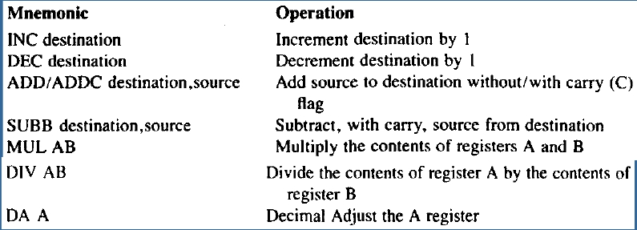
ARITHMETIC INSTRUCTIONS
▪ 8051 microcontroller has instruction to perform mathematical
calculations on data in order to alter program flow and modify
program actions.
▪ 8051 has sufficient capability to handle the data manipulations
such
as
addition,
subtraction,
multiplication,
division,
increment and decrement.
▪ 8051 has 24 arithmetic opcodes and are grouped into the
following types:

Slide 14
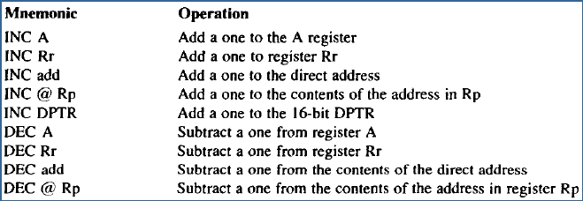
ARITHMETIC INSTRUCTIONS
Incrementing and Decrementing
▪ The simplest arithmetic operation involve incrementing or decrementing
the contents of a register Rp, or Register A, or direct and indirect
addresses.
▪
▪
▪
▪
▪
No math flags are affected
All 8-bit address contents overflow from FFh to 00h
DPTR is 16 bits; DPTR overflows from FFFFh to 0000h
All 8-bit address contents underflows from 00h to FFh
There is no DEC DPTR to match INC DPTR

Slide 15
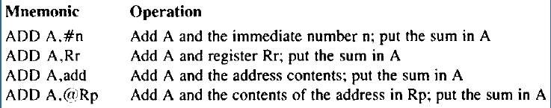
Arithmetic Instructions
Addition
▪ All addition is done with the A register as the destination of the result.
▪ All addressing modes may be used for the source: an immediate
number, a register, a direct address and an indirect address.
▪ Some instruction include the carry flag as an additional source of a
single bit that is included in the operation at the least significant bit
position.
▪ C flag is set to 1 if there is a carry out of bit position 7; it is cleared
otherwise
▪ AC flag is set to 1 if there is a carry out of bit 3; it is cleared otherwise.
▪ OV flag is set to 1 as per the logic expression: OV=C7 XOR C6, where
C7 and C6 are carry outs of bit position 7 and 6 respectively.

Slide 16
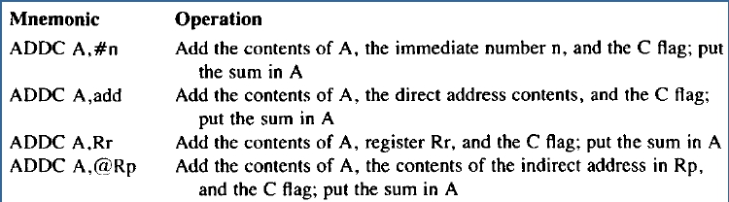
Arithmetic Instructions
Addition with Carry
▪ In multi-byte arithmetic, it is necessary to add the carry flag to
higher order bytes in the addition operations.
▪ The instruction used for this purpose is ADDC.
▪ C, AC and OV flags behave exactly as they do for the ADD
commands.

Slide 17
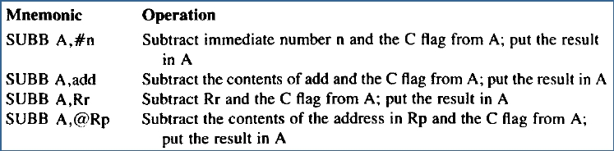
Arithmetic Instructions
Subtraction
• 8051 has commands to perform direct subtraction of two
signed, or unsigned numbers.
• Register A is the destination address for subtraction.
• All four addressing modes may be used for source addresses.
• The commands treat the carry flag as borrow and always
subtract the carry flag as a part of the operation.
• Remember to clear the carry flag to 0 if it is not to be included
as a part of the subtraction operation.

Slide 18
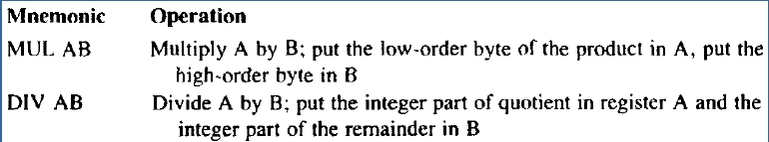
Arithmetic Instructions
Multiplication and Division
▪ Multiplication and division operations use registers A and B as both
source and destination addresses for the operation.
▪ In multiplication operation, the unsigned number in reg A is
multiplied by unsigned number in reg B.
▪ In division operation, the unsigned number in reg A is divided by
unsigned number in reg B.
▪ In multiplication operation, the OV flag is set if A X B > FFh. Setting
the OV flag does not mean that an error has occurred. Rather, it
signals that the number is larger than 8 bits. The carry flag is always
cleared to 0.
▪ In division operation, the OV flag is set upon division by 0. the carry
flag is always reset.

Slide 19

Arithmetic Instructions
BCD Arithmetic
▪ 8051 provides convenience for the programmers to the decimal
number system to represent all numbers in the program.
▪ The opcode that adjusts the result of BCD addition is the decimal
adjust A for addition (DAA) command.
▪ The DA A opcode only works when used with ADD and ADDC
commands and does not give correct adjustments for SUBB, MUL or
DIV commands.
▪ Example: If ACC contains BCD value of 59 then:
ADD A, #1 ; adds 1 to A, leaving 5A in A register
DA A
; then adjust the result to correct BCD value 60.

Slide 20
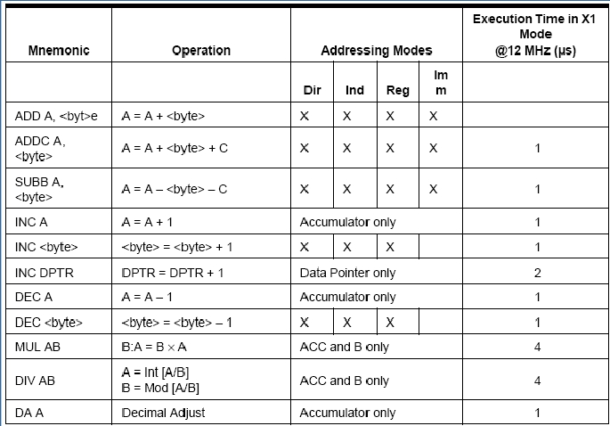
Arithmetic Instructions

Slide 21
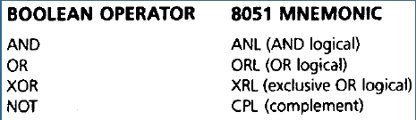
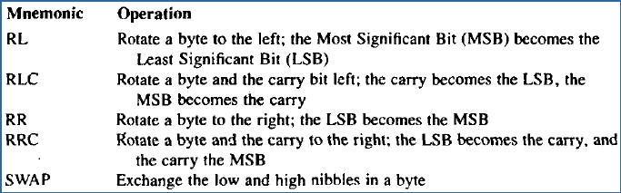
Logical Instructions
▪ 8051 logical instructions perform Boolean operations on bytes
of data on a bit-by-bit basis .
▪ There are also rotate opcodes that operate only on a byte, or
a byte and carry flag, to permit limited 8- and 9-bit shift
register operations.

Slide 22
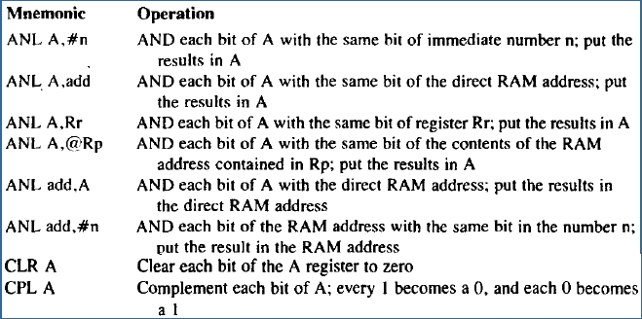
Logical Instructions
Byte-Level Logical Operations
▪ The byte-level logical operations use all the four addressing modes
(Immediate, Register, Direct and Indirect) for the source of a data
byte.
▪ These operations are called byte-level Boolean operations because
the entire byte is affected.
▪ Example:

Slide 23
Logical Instructions
Byte-Level Logical Operations
▪ Logical operations can be performed on any byte in internal
memory without going through the accumulator
▪ Example:
XRL P1,#FFH ; eight bits in Port 1 are read, each bit exclusive ORed. The
result is written back to Port 1.
▪ Rotate instructions (RLA, RR A) shift the accumulator one bit
to the left or right. For a left rotation, MSB rolls into LSB
position. For a right rotation, LSB rolls into MSB position.
▪ RLC A and RRC A perform similar operations on
concatenation of carry flag and accumulator.
▪ SWAPA: exchanges high and low nibbles within accumulator

Slide 24
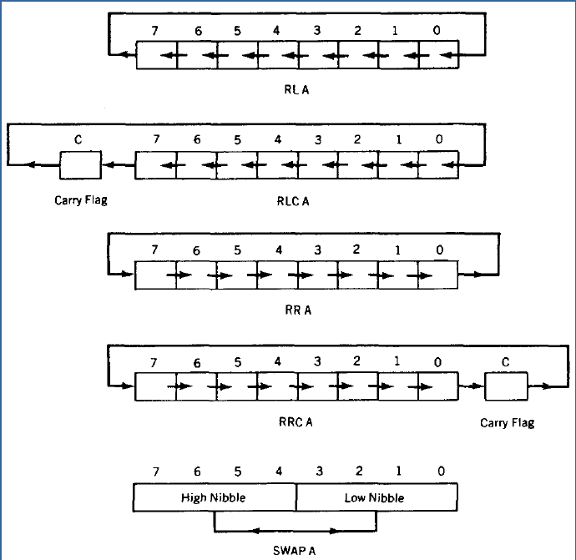

Slide 25
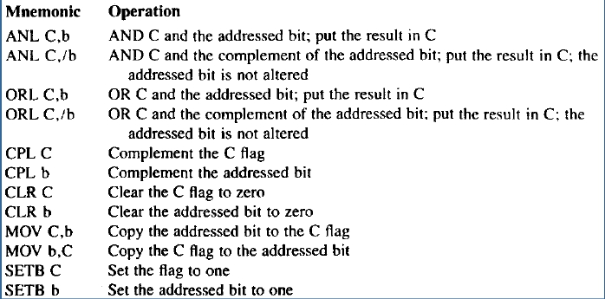
Logical Instructions
Bit-Level Logical Operations
▪ Many of the SFRs and a unique internal RAM area is bit
addressable and may be operated upon at the individual bit level.
▪ Advantage: Bit operators are efficient when speed of response is
needed. Bit operators yield compact program code that
enhances program execution speed.

Slide 26
InternalRAMBitAddresses
Byte Addresses | Bit Addresses
20 21 22 23 24 25 26 27 28 29 2A 2B 2C 2D 2E 2F | 00-07 08-0F 10-17 18-1F 20-27 28-2F 30-37 38-3F 40-47 48-4F 50-57 58-5F 60-67 68-6F 70-77 78-7F
SFRBitAddresses
SFR | Direct address | Bit address
A B IE IP P0 P1 P2 P3 PSW TCON SCON | 0E0 0F0 0A8 0B8 80 90 0A0 0B0 0D0 88 98 | 0E0-0E7 0F0-0F7 0A8-0AF 0B8-OBF 80-87 90-97 0A0-0A7 0B0-0B7 0D0-0D7 88-8F 98-9F

Slide 27
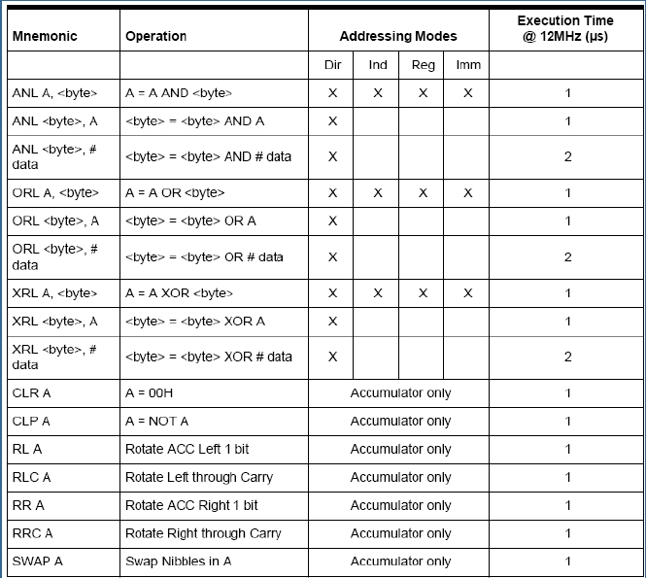
Logical Instructions

Slide 28
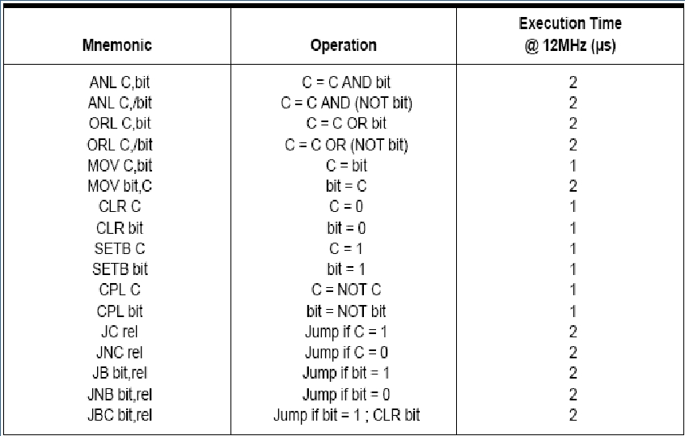
Boolean (Bit) Instructions

Slide 29
Data Transfers
The data transfer instruction may be divided into the
following three main types:
1.
2.
3.
MOV destination,source
PUSH source or POP destination
XCH destination,source
The following five types of opcodes are used to move data:
1.
2.
3.
4.
5.
MOV
MOVX
MOVC
PUSH & POP
XCH
Register-to-Register moves using Register Addressing
mode occur between A and R0 to R7

Slide 30
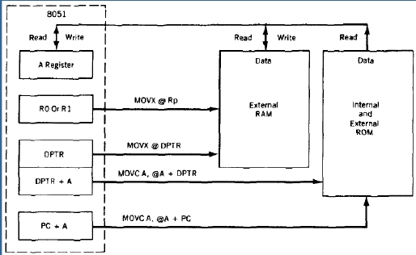
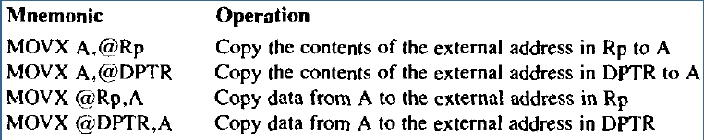
Data Transfers
External Data Moves
▪ all external data moves must involve the A register
▪ MOVX is normally used with external RAM or I/O addresses.

Slide 31
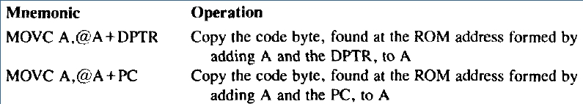
Data Transfers
Code Memory Read-Only Data Moves
▪ the data in program ROM can be accessed by using indirect
addressing and the A register in conjunction with either the PC
or DPTR.
▪ all data is moved from the code memory to the A register
▪ MOVC is normally used with internal or external ROM and
can address 4K of internal or 64K of external code.

Slide 32
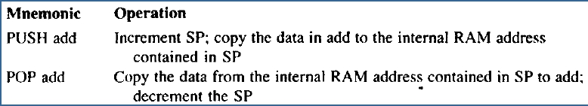
Data Transfers
PUSH and POP opcodes
▪ Stack is an area of internal RAM
▪ Stack Pointer (SP) register contains address of Top of the Stack
▪ PUSH & POP opcodes move the data between stack and specified
direct address.
▪ PUSH opcode copies data from source address to the stack
▪ POP opcode copies data from the stack to the destination address.
▪ When SP reaches FFh, it rolls-over to 00h (R0)
▪ RAM ends at address 7Fh; PUSHes above 7Fh results in errors

Slide 33
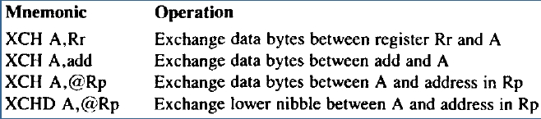
Data Transfers
Data Exchanges
▪ Exchange instruction move data in two directions: from source
to destination and from destination to source.
▪ All addressing modes except immediate mode may be used in
exchange opcodes.
▪ Exchanges between A and any port location copy the data on
the port pins to A, while data in A is copied to the port latch.
▪ All exchanges are internal to 8051
▪ All exchanges involve register A
▪ When using XCHD, the upper nibble of A and the upper nibble
of the address location in Rp do not change.

Slide 34
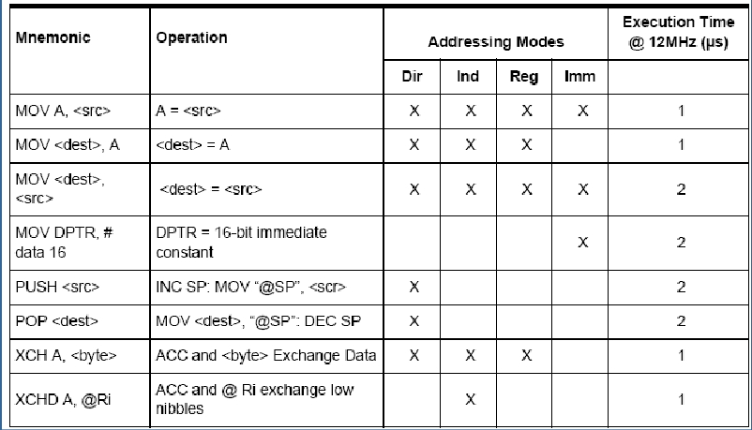
Data Transfers
Internal data RAM

Slide 35
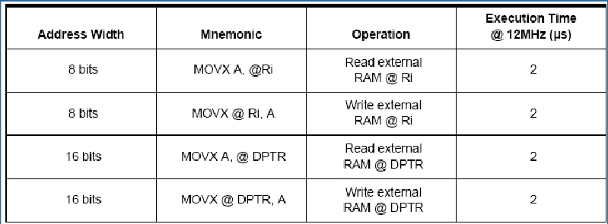
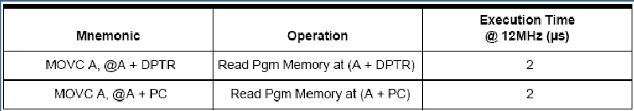
Data Transfers
External data RAM
Program ROM

Slide 36
Jump and Call Instructions
▪ The jump and calls are decision codes that alter the flow of
the program by examining the results of the action codes and
changing the contents of the program counter.
▪ A jump permanently changes the contents of the PC if certain
program condition exists.
▪ A Call temporarily changes the contents of the PC to allow
another part of the program to run.
▪ Jump and Calls may also be referred as ‘branches’.
▪ Types of decision opcodes:
1. Jump on bit conditions
2. Compare bytes and jump if not equal
3. Decrement byte and jump if not equal
4. Jump unconditionally
5. Call a subroutine
6. Return from a subroutine

Slide 37
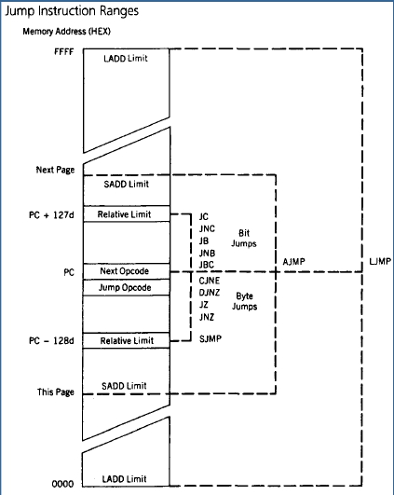
Jump and Call Instructions
Program Range
A jump or call instruction can replace
the contents of the PC with a new
▪
program
address
that
causes
program execution to begin at the
code located at the new address. The
difference, in bytes, of this new
address from the address in the
program where jump or call is located
is called the range of the jump or call.
Jump or Call instructions may have
one of the following three ranges:
❖ Relative: upto PC+127 bytes, PC-128
bytes away from the PC
❖ Absolute Short: anywhere on a 2K
byte range
❖ Absolute Long: anywhere in the
program memory
▪

Slide 38
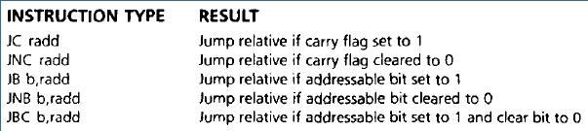
Jump and Call Instructions
Jumps
▪ Jump opcodes test an individual bit, or a byte, to check for
conditions that make the program jump to a new program
address.
▪ Jumps operate by testing for conditions that are specified in
the jump mnemonic. If the condition is true, then the jump is
taken. If the condition is false, then the instruction immediately
following the jump instruction is executed
▪ Bit jumps:
❖ Bit jumps operate according to the status of the carry flag in the PSW or
the status of any bit-addressable location.
❖ All bit jumps are relative to the PC

Slide 39
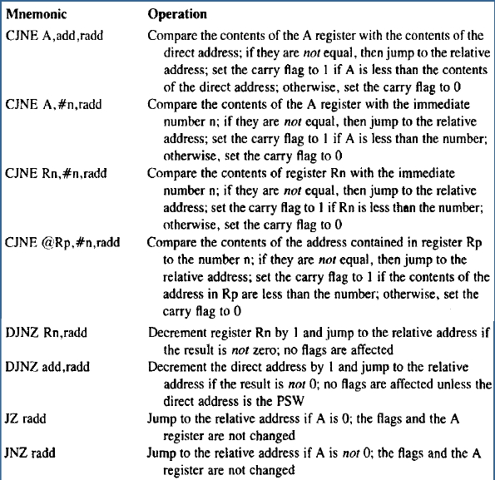
Jump and Call Instructions
Jumps
Byte jumps:
▪
These
instructions
are
that
jump
tests
bytes of data
▪
They
behave
as
bit
jumps.
All byte jumps are relative
to the PC.
CJNE doesn’t change the
contents of any register or
memory location. It can
change the CY flag to 1 if
the destination byte is
less than source byte.
There is no zero flag; the
JZ and JNZ instructions
checks the contents of A
register for 0.
▪
▪
▪

Slide 40
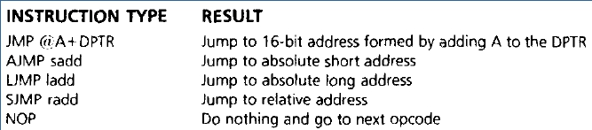
Jump and Call Instructions
Jumps
Unconditional Jumps:
▪ They do not test any bit or byte to determine whether the jump
should be taken. The jump is always taken.
▪ These are the only jumps that can jump to any memory
location.
▪ JMP @A+DPTR does not change A, DPTR or any flags.

Slide 41
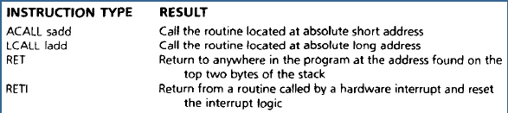
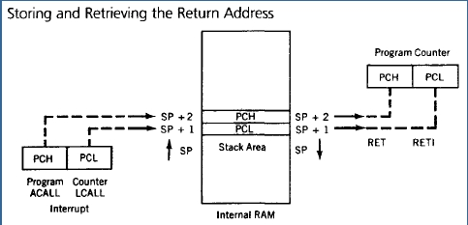
Jump and Call Instructions
Calls and subroutines
A Call, whether software or hardware initiated, causes a jump to the
address where the called subroutine is located.
At the end of the subroutine, the program resumes operation at the opcode
address immediately following the call.
Calls can be located anywhere in the program address space and can be
used many times.
The stack area of the internal RAM is used to store the return address
▪
▪
▪
▪

Slide 42
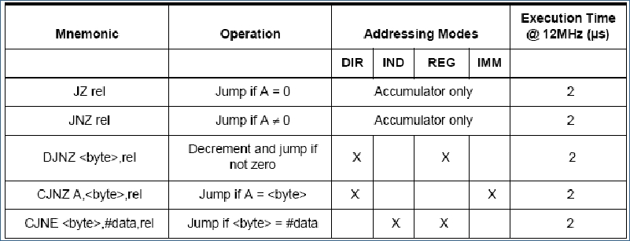
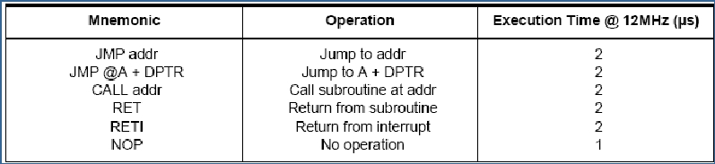
Jump Instructions
Conditional
Unconditional

